Slide 1



Project - 22 Travelling-Salesman-Problem-Using Genetic Algorithm
By :
180030166 - J. Kartish
180030191 - J. K. Nayana
180030255 - K. Gopika Manvitha

Slide 2
Abstract :-
The travelling salesman problem (TSP) is one of the extensively studied optimization problem .To solve this problem many techniques have been developed. Genetic algorithm is one among those which solves this problem by using the processes observed in natural evolution to solve various optimizations and search problems. In this project we have implemented traveling salesman problem using genetic algorithm .

Slide 3


Problem Definition :-
The problem says that a salesman is given a set of cities, he must find the shortest route to as to visit each city exactly once and return to the starting city. .

Slide 4
Genetic algorithms
Genetic algorithms are heuristic search algorithms inspired by the process that supports the evolution of life. The algorithm is designed to replicate the natural selection process to carry generation, i.e. survival of the fittest of beings. Standard genetic algorithms are divided into five phases which are:
Creating initial population.
Calculating fitness.
Selecting the best genes.
Crossing over.
Mutating to introduce variations.

Slide 5
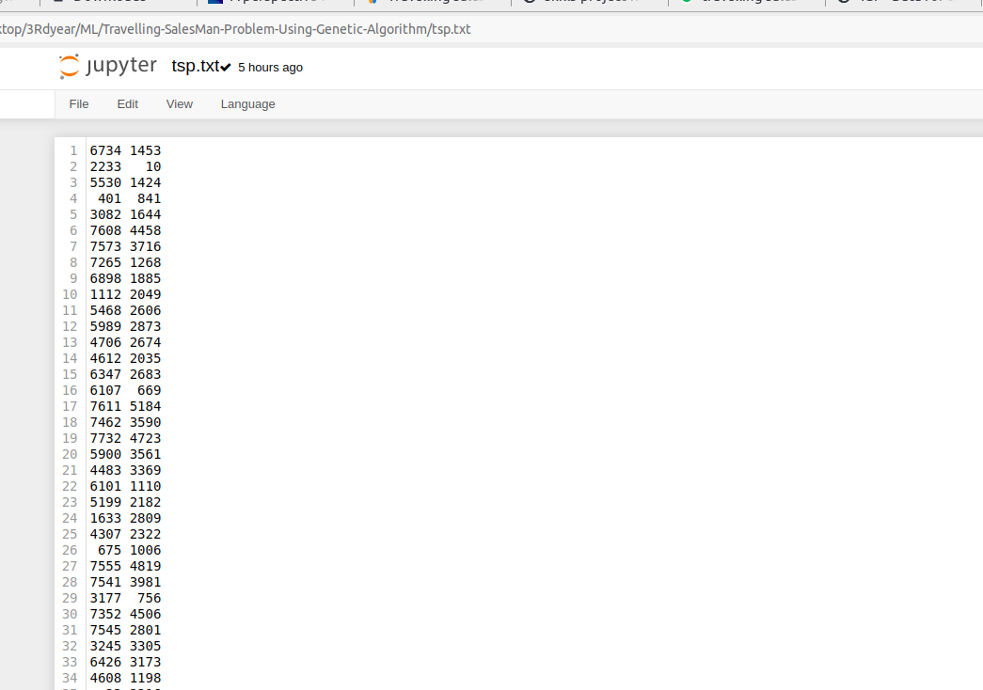
Data set :
The data from the below link contains set of X Y coordinates of different cities from different regions.
link :Tsp Dataset

Slide 6
Approach :
With Genetic algorithm we follow the following sequence of steps to find the best path :
Generate a random population , finding the path distance.
Select the elite chromosomes from the population.
Perform crossover and mutation to generate new generation.
Find the path distance again and continue the process until best off springs are generated.

Slide 7
Step1: Create random population
def generatePath(cities):
path = random.sample(cities, len(cities))
return path
cityList = [[77.580643,12.972442],[72.88261,19.07283],[77.216721,28.644800],[73.856255,18.516726]
,[85.158875,25.612677],[80.9231262,26.8392792],[74.797371,34.083656]]
population= [generatePath(cityList) for i in range(population size)]

Slide 8
Step2 : Select the elite chromosomes from the population
def path_fitness(cities):
total_dis = total_distance(cities)
fitness = 1 / float(total_dis)
return fitness
fitnessResults[i] = [path_fitness(population[i]) for i in range(population size)]
sorted(fitnessResults)
return fitnessResults[:elite size]

Slide 9
Step3 : Perform crossover and mutation to generate new generation
Two Point Crossover :
def do_crossover(first_parent, second_parent):
index1= int(random.random() * len(first_parent))
index2 = int(random.random() * len(second_parent))
first_split = min(index1,index2)
last_split = max(index1,index2)
partial_parent1 = [first_parent[i] for i in range(first_split, last_split)]
partial_parent2 = [i for i in second_parent if i not in tot_parent1]
tot = partial_parent1 + partial_parent2
return tot

Slide 10
Mutation :
def do_mutatation(indiv, mutat_rate):
for exchanged in range(len(indiv)):
if(random.random() < mutat_rate):
exchanged_with = int(random.random() * len(indiv))
city1 = indiv[exchanged]
city2 = indiv[exchanged_with]
indiv[exchanged] = city2
indiv[exchanged_with] = city1
return indiv

Slide 11
Step 4 : Continue the process until best offspring's generated
def GA(city_names,cities, population_size, eliteSize, mutat_rate, generations):
population = initialPopulation(cities,population_size)
print("Intial distance: " + str(1 / rankPathes(population)[0][1]))
for i in range(generations):
population = get_following_gen(population, eliteSize, mutat_rate)
optimal_route_id = rankPathes(population)[0][0]
optimal_route = population[optimal_route_id]
return optimal_route
result_lst = GA(city_names,cityList, population_size=100,
eliteSize=5, mutat_rate=0.01,
generations=500)

Slide 12
Future Scope :
The stochastic aspect of the mutation threshold and selection process removes consistency from the performance of GA.
Another couple of tests may yield entirely different results for each variation that may be more expected or entirely contradict what would be logically assumed.
However, if these results do accurately describe the behavior of the variations, the steady-state approach and tournament selection method may benefit in more creative applications, where exploration and a slow convergence may demonstrate an auditory or artistic process.
Overall, considering the total size of the search space, the genetic algorithm serves well in finding a solution in a relatively small number of generations.

Slide 13
Conclusion :
As TSP is an NP hard problem with Genetic Algorithm we can make it feasible in real time.
With best evolutionary techniques we can solve any problem in real time.
Genetic algorithms can be implemented to find a solution to the optimization problem of various types.

Slide 14
THANK YOU

